Slide 1
Regression Analysis
Multiple Linear Regression
Nicoleta Serban, Ph.D.
Professor
School of Industrial and Systems Engineering
Model Evaluation and Multicollinearity

Slide 2

About This Lesson

Slide 3
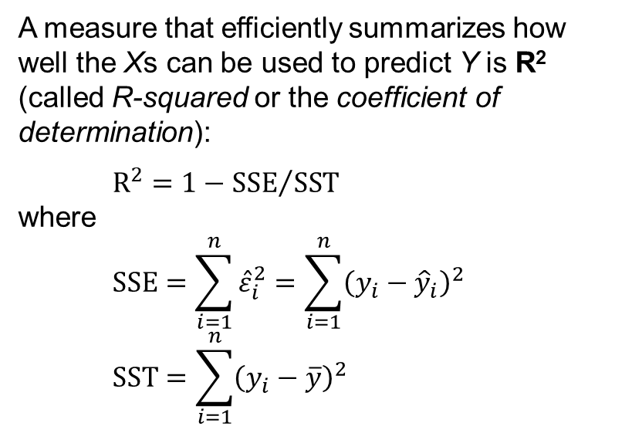
R²: Coefficient of Determination
A measure that efficiently summarizes how well the Xs can be used to predict Y is R² (called R-squared or the coefficient of determination):
$$R^{2}=1−{SSE}/{SST}$$
where
$$SSE=\sum_{i=1}^{n}{{\hat{ε}}_{i}^{2}}=\sum_{i=1}^{n}{{\left(y_{i}−{\hat{y}}_{i}\right)}^{2}}$$
$$SST=\sum_{i=1}^{n}{{\left(y_{i}−\overline{y}\right)}^{2}}$$
R² is interpreted as the proportion of total variability in Y that can be explained by the linear regression model.

Slide 4
R²: Notation and Terminology
SSE, SST, and SSR refer to sum of squared errors, sum of squares total, and sum of squares for regression. Unfortunately, the field of statistics abounds in inconsistent terminology and notation.
SSE: sometimes denoted SS_{error} or SS_{err}, is also known as RSS (residual sum of squares) and SS_{res} (sum of squared residuals, sometimes SSR).
SST: sometimes written as SS_{total} or SS_{tot}. It is also called total sum of squares and written as TSS.
SSR: also called the sum of squares due to regression, and it is sometimes written as SS_{reg}. It's also called explained sum of squares (ESS). Don't confuse ESS with SSE, and, for R², remember that SSR is SS regression, not SS residuals!

Slide 5
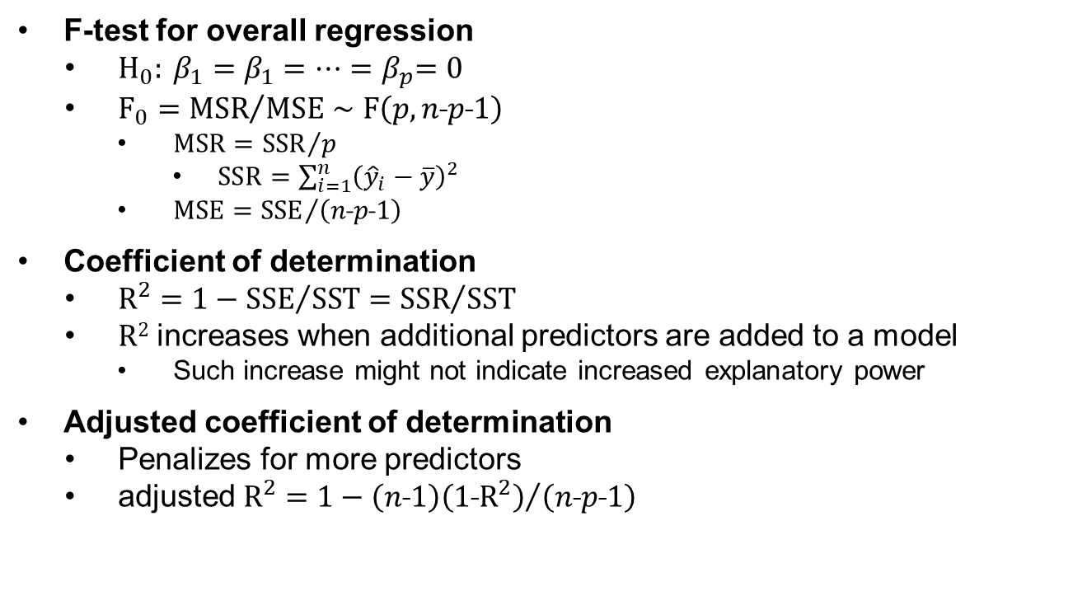
Model Evaluation
F-test for overall regression
  $H_{0}: β_{1}=β_{1}{=⋯=β}_{p}=0$
  $F_{0}={MSR}/{MSE}∼F\left(p, n\text{˗}p\text{˗}1\right)$
    $MSR={SSR}/p$
      $SSR=\sum_{i=1}^{n}{{\left({\hat{y}}_{i}−\overline{y}\right)}^{2}}$
    $MSE={SSE}/{\left(n\text{˗}p\text{˗}1\right)}$
Coefficient of determination
  $R^{2}=1−{SSE}/{SST}={SSR}/{SST}$
  R² increases when additional predictors are added to a model
    Such increase might not indicate increased explanatory power
Adjusted coefficient of determination
  Penalizes for more predictors
  adjusted $R^{2}=1−{\left(n\text{˗}1\right)\left(1\text{˗}R^{2}\right)}/{\left(n\text{˗}p\text{˗}1\right)}$

Slide 6
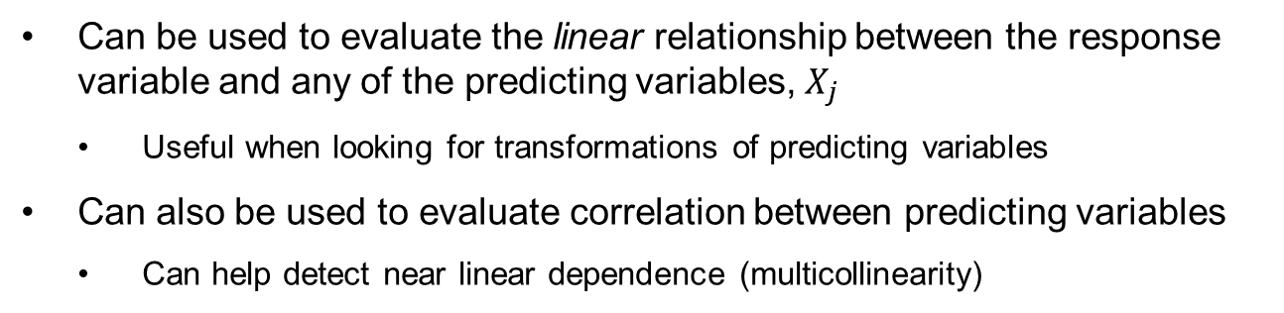
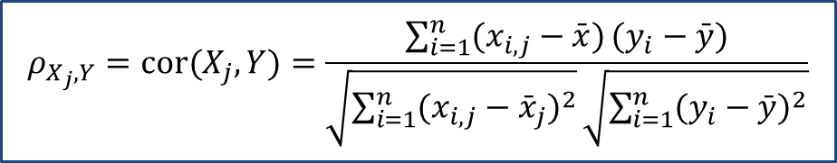
Correlation Coefficient
A statistic that efficiently summarizes how well one of the Xs is linearly related to Y (or to another X) is ρ, the (Pearson) correlation coefficient:
$$ρ_{X_{j},Y}=cor(X_{j},Y)=\frac{\sum_{i=1}^{n}{(x_{i,j}−\bar{x})}(y_{i}−\bar{y})}{\sqrt{\sum_{i=1}^{n}{(x_{i,j}−{\bar{x}}_{j})^{2}}}\sqrt{\sum_{i=1}^{n}{(y_{i}−\bar{y})^{2}i_{j}}}}$$
Can be used to evaluate the linear relationship between the response variable and any of the predicting variables, $X_{j}$
  Useful when looking for transformations of predicting variables
Can also be used to evaluate correlation between predicting variables
  Can help detect near linear dependence (multicollinearity)

Slide 7
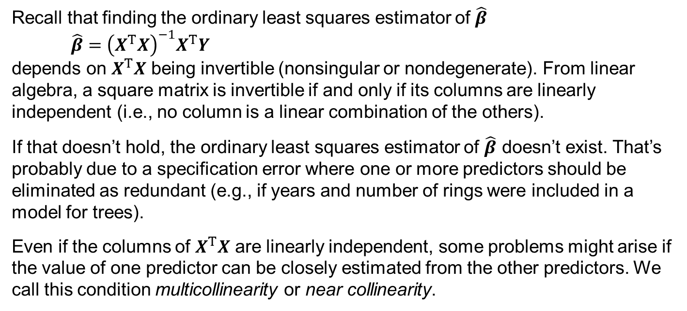
Multicollinearity
Recall that finding the ordinary least squares estimator of $\hat{β}$
$$\hat{β}={\left(X^{T}X\right)}^{−1}X^{T}Y$$
depends on $X^{T}X$ being invertible (nonsingular or nondegenerate). From linear algebra, a square matrix is invertible if and only if its columns are linearly independent (i.e., no column is a linear combination of the others).
If that doesn’t hold, the ordinary least squares estimator of $\hat{β}$ doesn’t exist. That’s probably due to a specification error where one or more predictors should be eliminated as redundant (e.g., if years and number of rings were included in a model for trees).
Even if the columns of $X^{T}X$ are linearly independent, some problems might arise if the value of one predictor can be closely estimated from the other predictors. We call this condition multicollinearity or near collinearity.

Slide 8
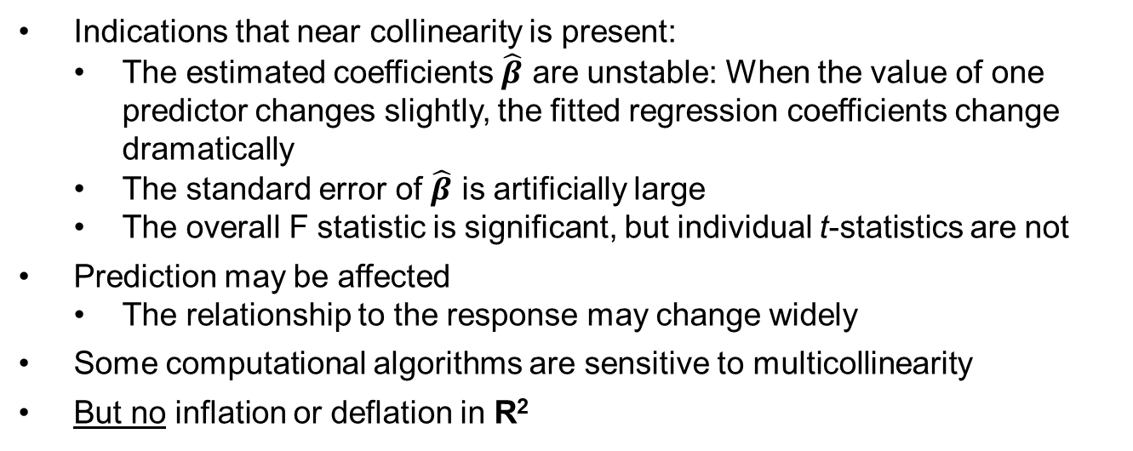
Multicollinearity
Indications that near collinearity is present:
  The estimated coefficients $\hat{β}$ are unstable: When the value of one predictor changes slightly, the fitted regression coefficients change dramatically
  The standard error of $\hat{β}$ is artificially large
  The overall F statistic is significant, but individual t-statistics are not
Prediction may be affected
  The relationship to the response may change widely
Some computational algorithms are sensitive to multicollinearity
But no inflation or deflation in R²

Slide 9
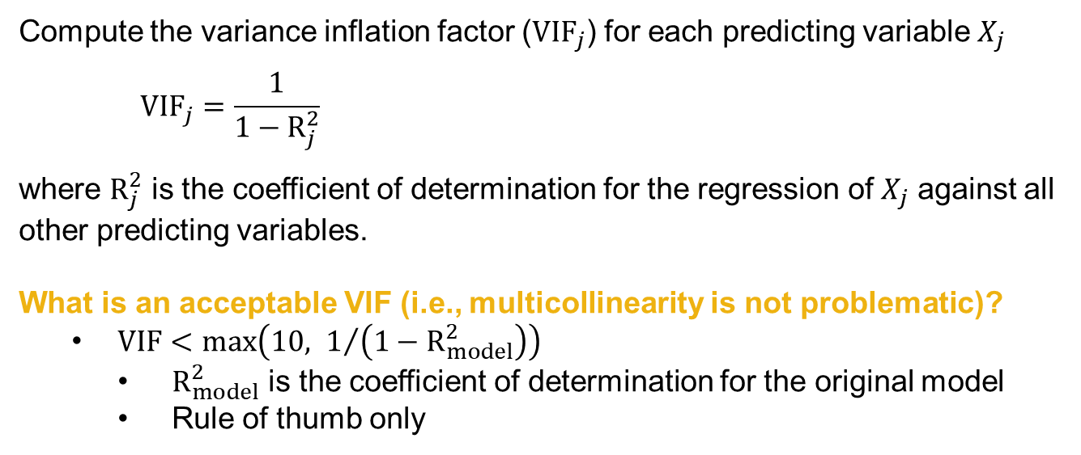
Multicollinearity Diagnosis
Compute the variance inflation factor ($VIF_{j}$) for each predicting variable $X_{j}$
$$VIF_{j}=\frac{1}{1−R_{j}^{2}}$$
where $R_{j}^{2}$ is the coefficient of determination for the regression of $X_{j}$ against all other predicting variables.
What is an acceptable VIF (i.e., multicollinearity is not problematic)?
  $VIF<max\left(10, 1/{\left(1−R_{model}^{2}\right)}\right)$
    $R_{model}^{2}$ is the coefficient of determination for the original model
    Rule of thumb only

Slide 10
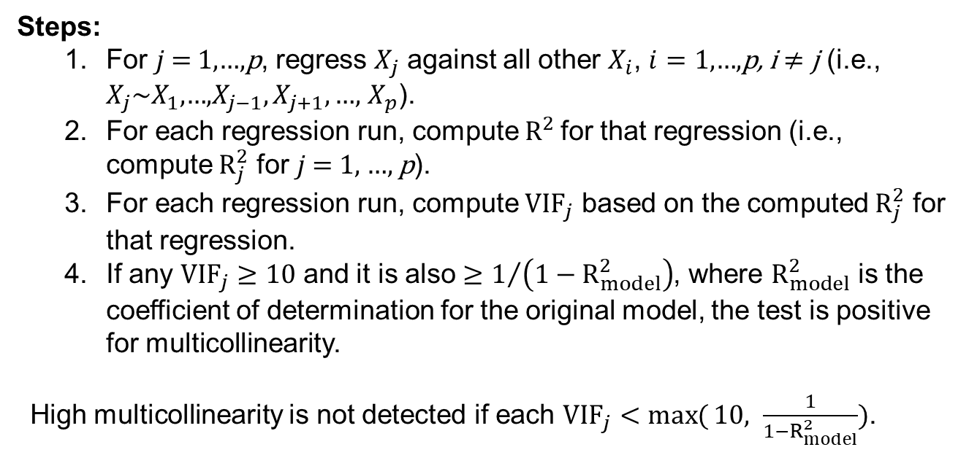
Multicollinearity Diagnosis
Steps:
  For $j$ = 1,…,p, regress $X_{j}$ against all other $X_{i}$, $i=1\text{,…,}\text{p}\text{, }\text{i}≠\text{j}$ (i.e., $X_{j}\sim X_{1}\text{,…,}X_{j−1},X_{j+1},\text{…,}$ $X_{p}$).
  For each regression run, compute $R^{2}$for that regression (i.e., compute $R_{j}^{2}$ for $j$ = 1, …, p).
  For each regression run, compute $VIF_{j}$ based on the computed $R_{j}^{2}$ for that regression.
  If any $VIF_{j}≥10$ and it is also $≥1/{\left(1−R_{model}^{2}\right)}$, where $R_{model}^{2}$ is the coefficient of determination for the original model, the test is positive for multicollinearity.
High multicollinearity is not detected if each $VIF_{j}<\max{(}10, \frac{1}{1−R_{model}^{2}})$.

Slide 11
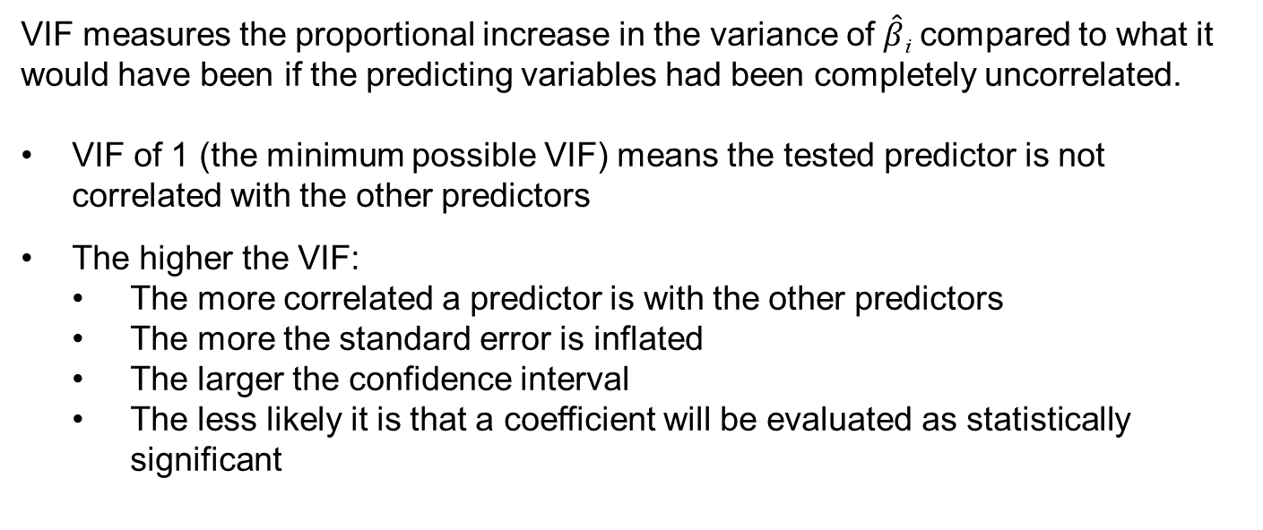
Multicollinearity Interpretation
VIF measures the proportional increase in the variance of $\hat{β}$_{i} compared to what it would have been if the predicting variables had been completely uncorrelated.
VIF of 1 (the minimum possible VIF) means the tested predictor is not correlated with the other predictors
The higher the VIF:
  The more correlated a predictor is with the other predictors
  The more the standard error is inflated
  The larger the confidence interval
  The less likely it is that a coefficient will be evaluated as statistically significant

Slide 12

Summary

